Slide 1
Toxicology Part Two

Slide 2
Collection and Preservation
Must ensure the chain of custody is followed.
Must ensure proper packaging so contents make it to lab.
Most often the original package is sufficient for transport.
Packaging must be marked with responding officer and collectors identification information to ensure beginning of chain of custody.

Slide 3
Drug Identification
With all of the known and unknown drugs that can be found it is necessary to chose the proper test to identify the substance.
Two phases of testing are used to identify unknowns
Presumptive Testing
Confirmative Testing

Slide 4
Presumptive Testing
Screening test that is nonspecific and preliminary in nature to reduce the possibilities to a manageable number.
This objective is often accomplished by subjecting the material to a series of color tests that will produce characteristic colors for the more commonly encountered illicit drugs.

Slide 5
Presumptive Color Test
Type: Marquis Color​
​
Chemicals:​
Formaldehyde and sulfuric acid​
​
Meaning of Results: ​
Heroine, morphine and most opium-based drugs will turn the solution purple. Amphetamines will turn it orange-brown.​
Notes:
Can not conduct in class because uses formaldehyde

Slide 6
Presumptive Color Test
Type: Scott (Cobalt thiocyanate)​
​
Chemicals:​
cobalt thiocyanate, distilled water, glycerin, hydrochloric acid, chloroform​
​
Meaning of Results: ​
Cocaine will turn the solution blue.

Slide 7
Presumptive Color Test
Type: Dille-Koppanyi​
​
Chemicals:​
Cobalt acetate and isopropylamine​
​
Meaning of Results: ​
Barbiturates will turn the solution violet-blue.

Slide 8
Presumptive Color Test
Type: Van Urk​
​
Chemicals:​
P-dimethylaminobenzaldehyde, hydrochloric acid, ethyl alcohol​
​
Meaning of Results: ​
LSD will turn the solution blue-purple.

Slide 9
Presumptive Color Test
Type: Duquenois-Levine Test​
​
Chemicals:​
Vanillin, acetaldehyde, ethyl alcohol​
​
Meaning of Results: ​
LSD will turn the solution blue-purple.​

Slide 10
Other Presumptive Tests
Microcrystalline tests can also be used to identify specific drug substances by studying the size and shape of crystals formed when the drug is mixed with specific reagents.

Slide 11
Advantages and Disadvantages
Scientists are able to use these simple and easy techniques to identify unknown substances.​
​No sophisticated equipment is necessary for color tests.​
​Inexpensive​
​Quick results and analysis​
​Not sensitive for small amounts​

Slide 12
Confirmative Testing
Forensic chemists will employ a specific test to identify a drug substance to the exclusion of all other known chemical substances.
In 1997, the Scientific Working Group for the Analysis of Seized Drugs (SWGDRUG) was established. ​
​The mission of SWGDRUG is to recommend minimum standards for the forensic examination of seized drugs and to seek international acceptance for those standards. http://www.swgdrug.org/
Not only is it necessary to determine the type of drug but it may also be necessary to determine the amount of drug (required for some sentencing laws)

Slide 13
Confirmative Testing
Qualitative tests can define what type of drug is present but lacks the ability to determine how much drug is present.​
​​
In a quantitative test, the sample is weighed and then the test is used to estimate what mass of the sample is the drug. The mass of the drug is divided by the total mass to give the percentage of drug in the sample.
Various criminal charges depend on knowing how much of a drug is present. This requires a quantitative test.​

Slide 14
Categories of Drug Analysis
Category A | Category B | Category C
Infrared Spectroscopy | Capillary Electrophoresis | Color Tests
Mass Spectrometry | Gas Chromatography | Fluorescence Spectroscopy
Nuclear Magnetic Resonance Spectroscopy | Ion Mobility Spectrometry | Immunoassay
Raman Spectroscopy | Liquid Chromatography | Melting Point
X-Ray Diffractometry | Microcrystalline Tests | Ultraviolet Spectroscopy
 | Pharmaceutical Identifiers
 | Thin Layer Chromatography
 | Cannabis only: Macroscopic and Microscopic Examination
Notes:
Chromatography is a means of separating and tentatively identifying the components of a mixture.
The theory of chromatography is based on the observation that chemical substances have a tendency to partially escape into the surrounding environment when dissolved in a liquid or when absorbed on a solid surface.
In chromatography, one phase is always made to move in one direction over a stationary or fixed phase.
Those materials that have a preference for the moving phase will slowly pull ahead and separate from those substances that prefer to remain in the stationary phase.

Slide 15
Chromatography
Chromatography is a means of separating and tentatively identifying the components of a mixture.
The theory of chromatography is based on the observation that chemical substances have a tendency to partially escape into the surrounding environment when dissolved in a liquid or when absorbed on a solid surface.
In chromatography, one phase is always made to move in one direction over a stationary or fixed phase.
Those materials that have a preference for the moving phase will slowly pull ahead and separate from those substances that prefer to remain in the stationary phase.

Slide 16
Chromatography
Two main types
Gas Chromatography
Thin Layer Chromatography

Slide 17
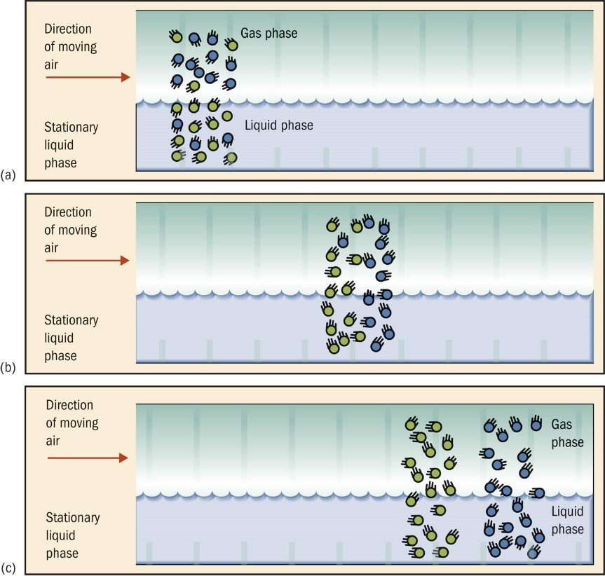
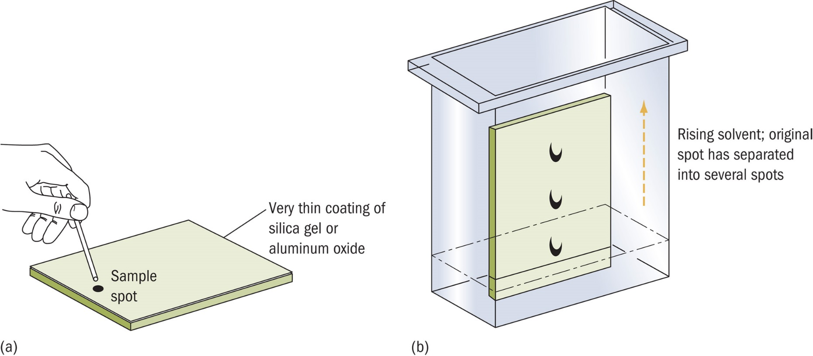
Notes:
Upper Left - In this illustration of chromatography, the molecules represented by the blue balls have a greater affinity for the upper phase and hence will be pushed along at a faster rate by the moving air. Eventually, the two sets of molecules will separate from each other, completing the chromatographic process.
Lower Right - a) In thin-layer chromatography, a liquid sample is spotted onto the granular surface of a gel-coated plate. (b) The plate is placed into a closed chamber that contains a liquid. As the liquid rises up the plate, the components of the sample distribute themselves between the coating and the moving liquid. The mixture is separated, with substances with a greater affinity for the moving liquid traveling up the plate at a faster speed.

Slide 18
Spectrophotometry
Just as a substance can absorb visible light to produce color, many of the invisible radiations of the electromagnetic spectrum are likewise absorbed.
Spectrophotometry, an important analytical tool, measures the quantity of radiation that a particular material absorbs as a function of wavelength and frequency.

Slide 19
UV and IR Spectroscopy
Currently, most forensic laboratories use UV and IR spectrophotometers to characterize chemical compounds.
The simplicity of the UV spectrum facilitates its use as a tool for determining a material’s probable identity, although it may not provide a definitive result.
The IR spectrum provides a far more complex pattern.
Different materials always have distinctively different infrared spectra; each IR spectrum is therefore equivalent to a “fingerprint” of that substance.

Slide 20
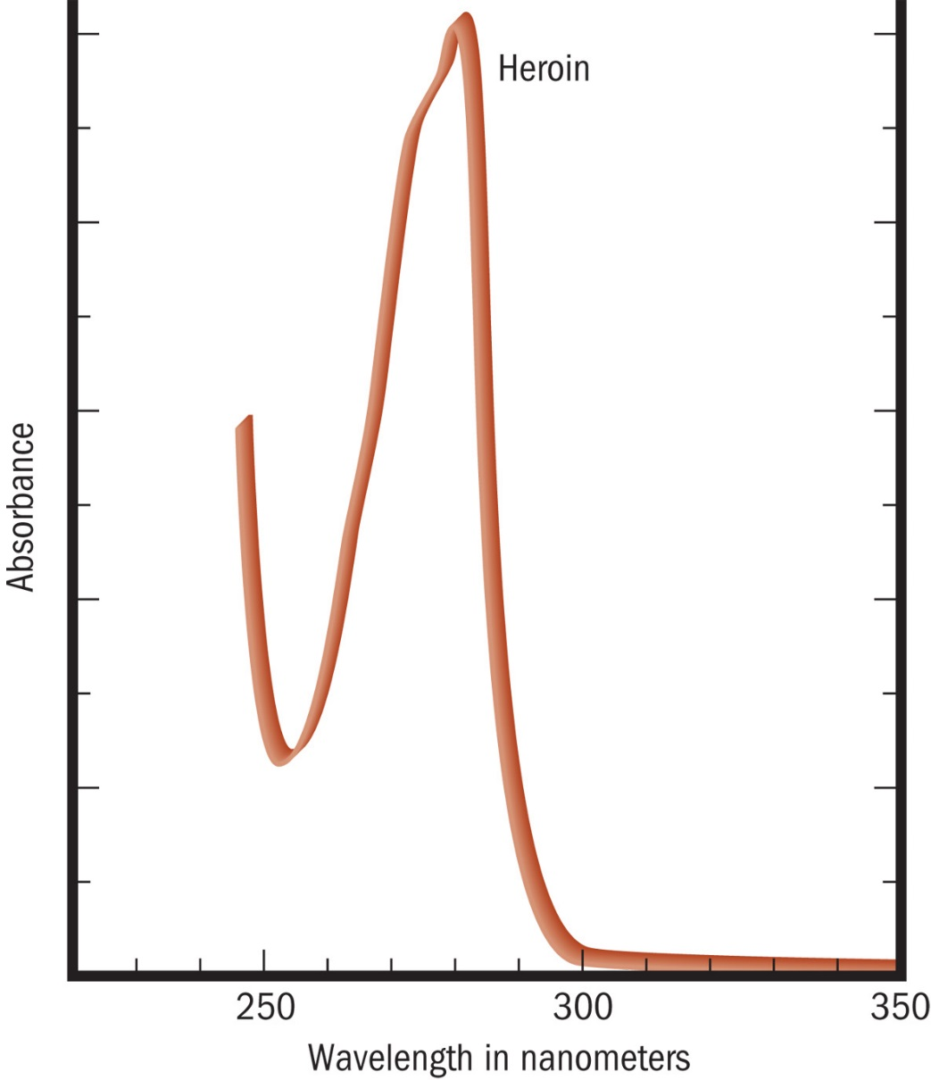
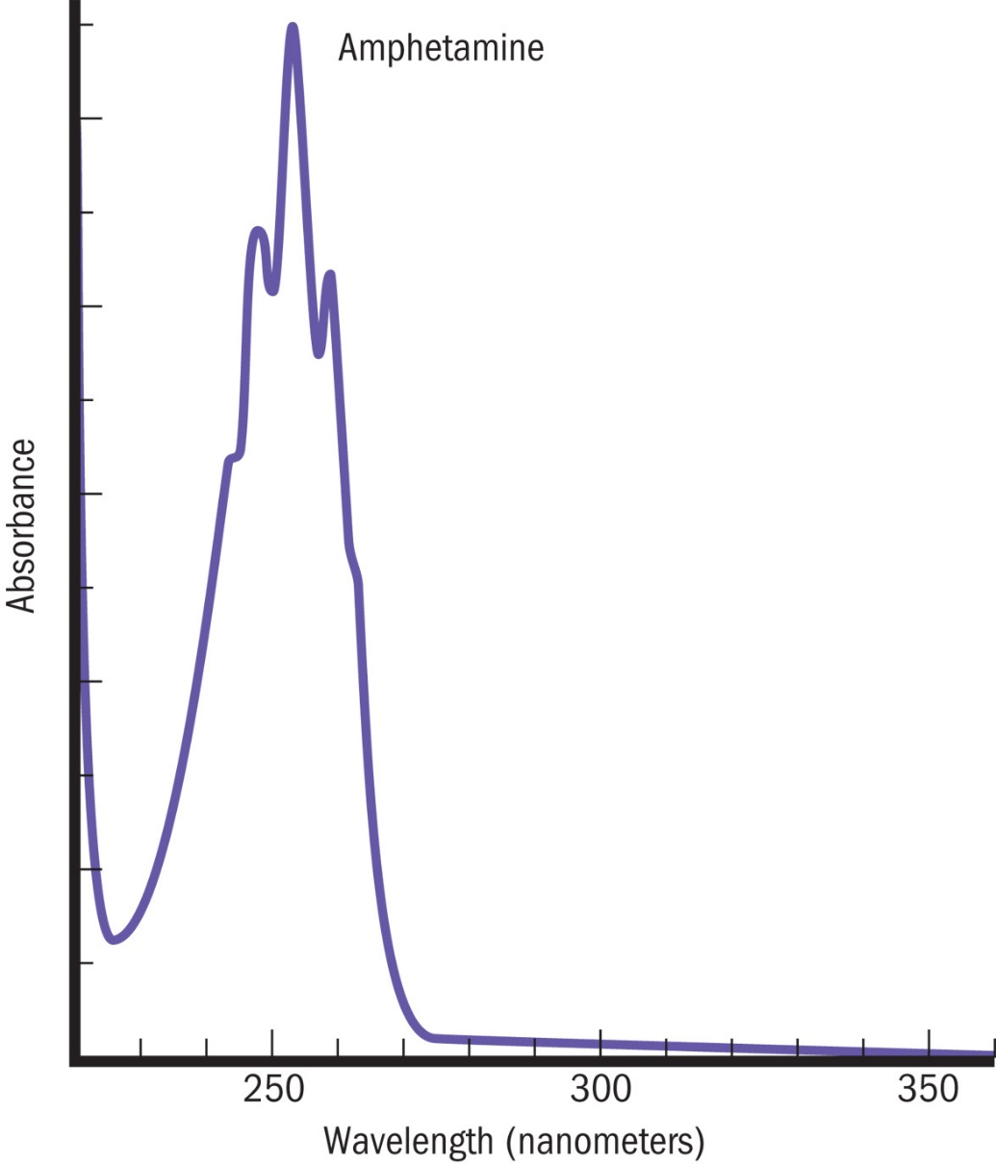
UV Spectrums

Slide 21
Mass Spectroscopy
A beam of high-energy electrons collide with a material, producing positively charged ions.
These positive ions almost instantaneously decompose into numerous fragments, which are separated according to their masses.
The unique feature of mass spectrometry is that under carefully controlled conditions, no two substances produce the same fragmentation pattern.
Notes:
It is possible to connect the GC to the mass spec, so the separated substances can then be fragmented based on size.

Slide 22
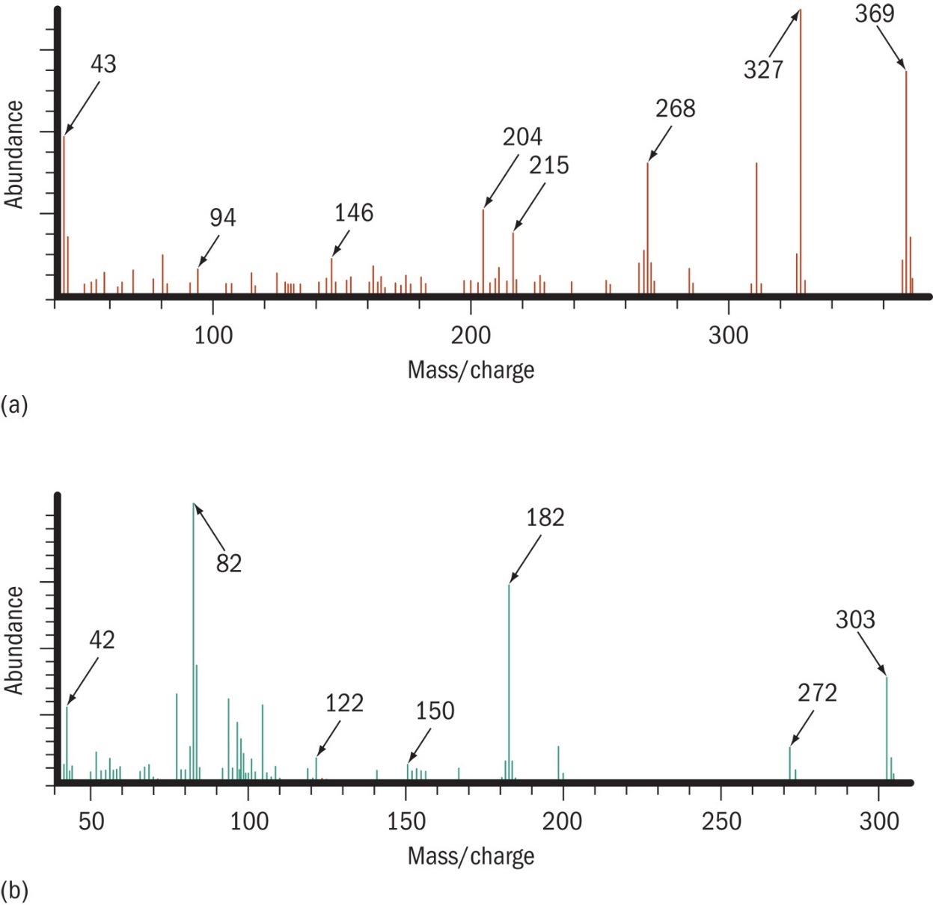
Mass Spectrums of Heroin (red) and Cocaine (blue)

Slide 23
Drug Test Selection
When a validated Category A technique is incorporated into an analytical scheme, at least one other technique (from either Category A, B or C) shall be used.
When a Category A technique is not used, at least three different validated techniques shall be employed. Two of the three techniques shall be based on uncorrelated techniques from Category B.

Slide 24
Analysis of Controlled Substances
All Category A and botanical identifications shall have data that are reviewable.
Where a Category A technique is not used, the requirement for reviewable data applies to category B techniques.
Printed spectra, chromatograms, digital images, photographs or photocopies (color, where appropriate) of TLC plates
Contemporaneous documented peer review for microcrystalline tests
Reference to published data for pharmaceutical identifiers (physical characteristics of tablets, capsules or packaging indicating the identity, manufacturer, or quantity of substances present)
For cannabis and botanical materials only: recording of detailed descriptions of morphological characteristics.

Slide 25
Drunk Driving
Over 31% of traffic deaths in the United States were related to alcohol in 2012*.
Traditional roadside testing methods do not confirm that a driver is over the legal blood alcohol content limit.
Officers utilize portable Breathalyzers to quantify the amount of alcohol in the suspect’s blood.
*CDC Injury Prevention and Control: Motor Vehicle Safety

Slide 26
Alcohol Absorption
Alcohol appears in the bloodstream within minutes of consumption.
When all the alcohol has been absorbed, a maximum alcohol level is reached in the blood; and the post-absorption or elimination period begins.
For an average human drinking on an empty to modestly full stomach, alcohol is absorbed entirely into the blood stream 30-90 minutes after the completion of drinking. When drinking on a full stomach. the absorption time can be as long as 2-4 hours
Notes:
Type of alcohol affects rate of absorption. Beer is absorbed more slowly than 80 proof alcohol due to the carbohydrates

Slide 27
Alcohol Elimination
Elimination of alcohol throughout the body is accomplished through oxidation and excretion.
Oxidation takes place almost entirely in the liver, where the enzyme alcohol dehydrogenase converts alcohol to acetic acid and then into carbon dioxide and water.
Notes:
About five percent of the alcohol is excreted unchanged in the breath, urine, and perspiration.

Slide 28
Alcohol Testing
Alcohol intoxication is legally defined by the blood alcohol concentration (BAC) level.
Blood alcohol concentration is defined as percent weight per volume. Hence, 0.10% is equivalent to 0.10 grams per 100 milliliters of blood.
Taking a blood or urine sample in the field for later analysis in the laboratory is not practical or efficient for detaining drivers suspected of driving while impaired (DWI) or driving under the influence (DUI).
Experimental evidence has verified that the amount of alcohol exhaled in the breath is in direct proportion to the blood concentration and is directly proportional to alcohol in the brain.

Slide 29
Alcohol Testing
Alcohol gets absorbed from the stomach and intestines into the bloodstream.
Alcohol is not chemically changed in the bloodstream.
As the blood goes through the lungs, some of the alcohol moves across the membranes of the lung's air sacs into the air, because alcohol will evaporate from a solution.
The concentration of the alcohol in the lungs is related to the concentration of the alcohol in the blood with a ratio of 1 to 2100 at 34°C
It can be detected by breath alcohol testing devices, such as a Breathalyzer.
Notes:
In other words, 1 milliliter of blood contains nearly the same amount of alcohol as 2,100 milliliters of alveolar breath.

Slide 30
Alcohol Testing Devices
Testing Devices generally use infrared spectrophotometer technology, electrochemical fuel cell technology, or a combination of the two.
Hand-held field testing devices are generally based on electrochemical platinum fuel cell analysis and, depending upon jurisdiction, may be used by officers in the field as a form of "field sobriety test" or as evidential devices in point of arrest testing.
Results of portable handheld roadside testers are not admissible in court
If positive results found further testing required usually using GC
Notes:
Fuel Cell Technology
The fuel cell uses a chemical reaction to generate an electrical signal in response to the breakdown of alcohol in the fuel cell.
The fuel cell converts alcohol and water into acetic acid, H⁺, and e⁻ at the anode.
At the cathode, H⁺ and e⁻ combine with atmospheric oxygen to regenerate the water. This net reaction involves a flow of electrons from anode to cathode.
The electron flow is measured and the signal is displayed on the readout.
More alcohol releases more electrons.

Slide 31
Factors Affecting Blood Alcohol Tests
Drinking on empty stomach (faster metabolism)
Drinking with a fever (false positive)
Using mouthwash or breath spray (false positives)
No good way to spoof the systems.

Slide 32
Legal Limit
The American Medical Association says that a person can become impaired when the blood alcohol level hits 0.05.
If a person's BAC measures 0.08, it means that there are 0.08 grams of alcohol per 100 ml of blood.
As of 2004, all 50 U.S. States have adopted the 0.08 standard for drunkenness, with lower limits for some classes of offenders like truck drivers or those under 21.

Slide 33
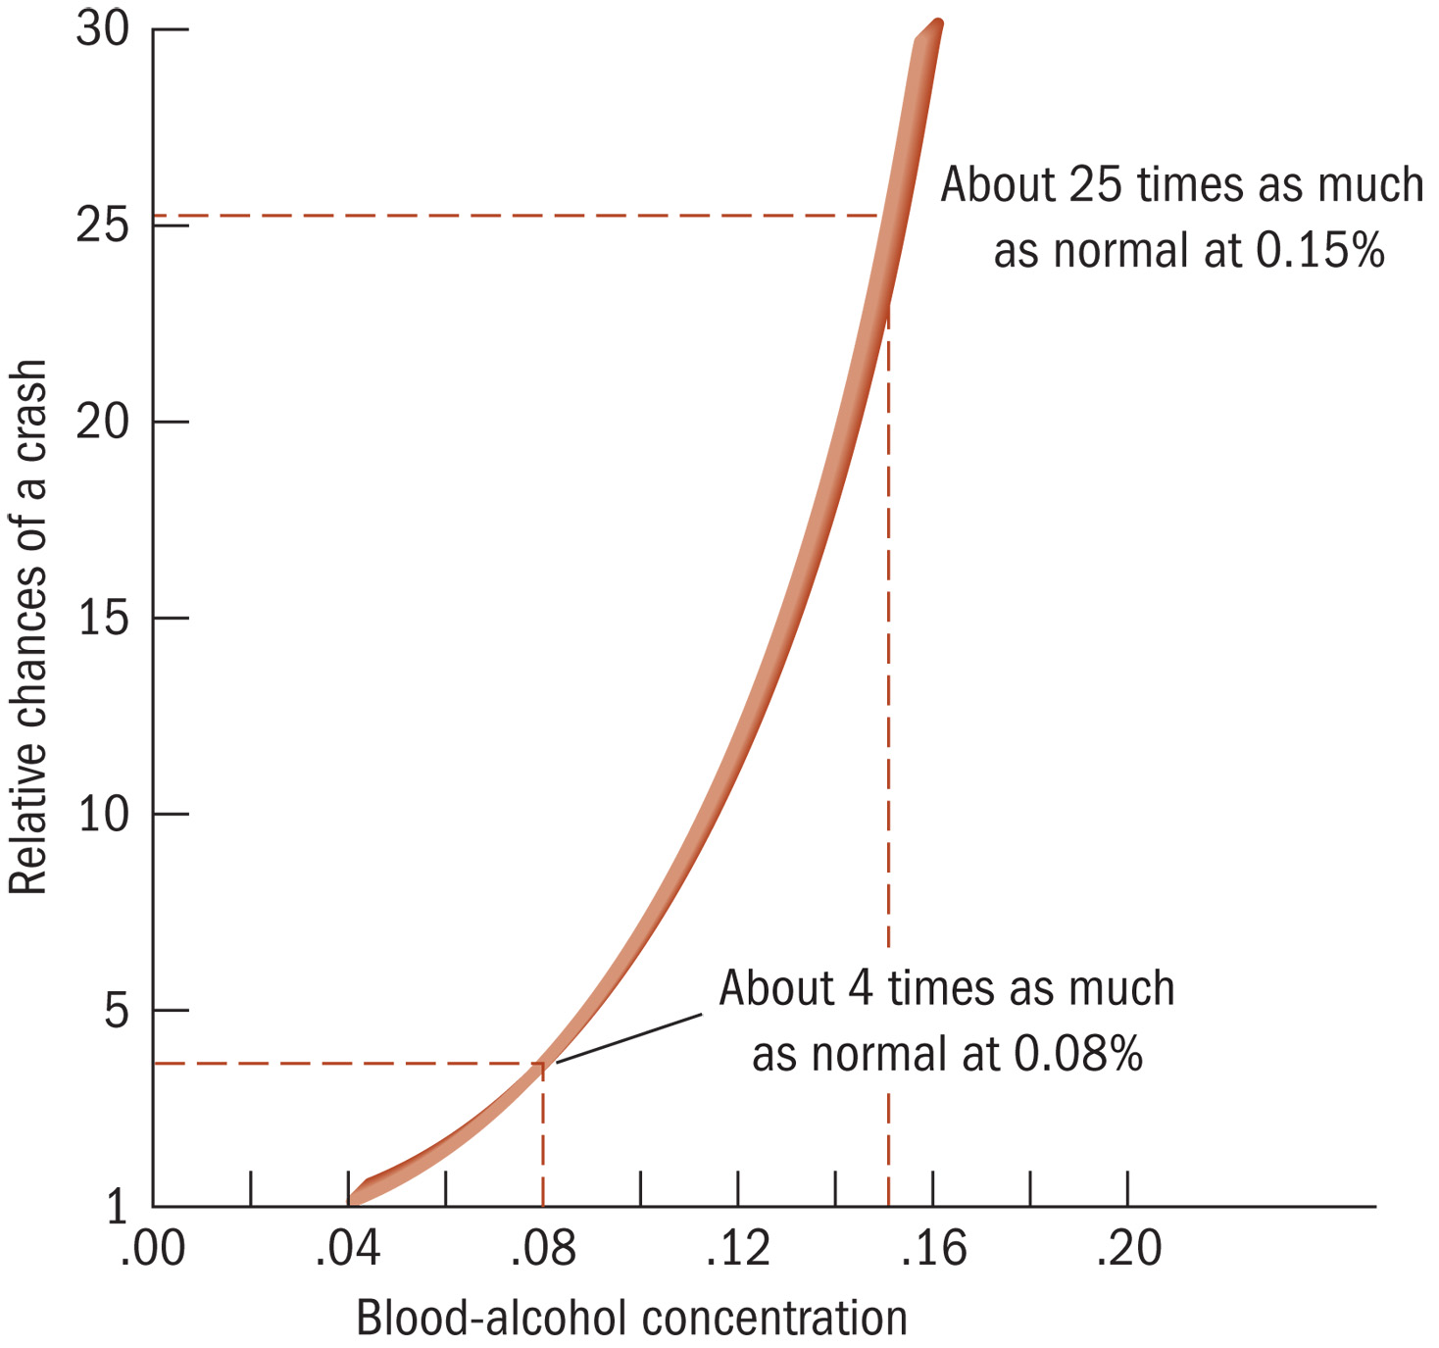
Increased driving risk in relation to blood-alcohol concentration

Slide 34
Alcohol and the Law
To prevent a person’s refusal to take a test for alcohol consumption, all the states have adopted an “implied consent” law. This law states that the operation of a motor vehicle on a public highway must either consent to a test for alcohol intoxication, if requested, or lose his or her license for some designated period.
In Schmerber v. California (1966), the Supreme Court ruled that the taking of blood samples was not protected by the fifth amendment.
In a 2013 decision the Supreme Court in Misssouri v. McNeely ruled that police should obtain a search warrant prior to the drawing of a person’s blood for alcohol testing.

Slide 35
Detecting Drugs in Hair
Drugs present in blood diffuse through the capillary walls into the base of the hair and become permanently entrapped in the hair’s hardening protein structure.
As the hair continues to grow, the drug’s location on the hair shaft becomes a historical marker for delineating drug intake.
The chronology of drug intake may be distorted by drugs penetrating the hair’s surface as a result of environmental exposure, or drugs may enter the hair’s surface through sweat.
Notes:
Given that the average human head hair grows at the rate of 1 centimeter per month, analyzing segments of hair for drug content may define the timeline for drug use

Slide 36
Heavy Metal Poisoning
To Screen for Bismuth, Antimony, Arsenic, Mercury, and Thallium
suspect body fluid is dissolved in a hydrochloric solution and a copper s strip is inserted into the solution. The presence of a silvery or dark coating on the copper indicates the presence of a heavy metal.

Slide 37
CO Poisoning
spectrophotometric methods determine the amount of carboxyhemoglobin relative to oxyhemoglobin or total hemoglobin; or a volume of blood can be treated with a reagent to liberate the carbon monoxide, which is then measured by gas chromatography.

